Slide 1

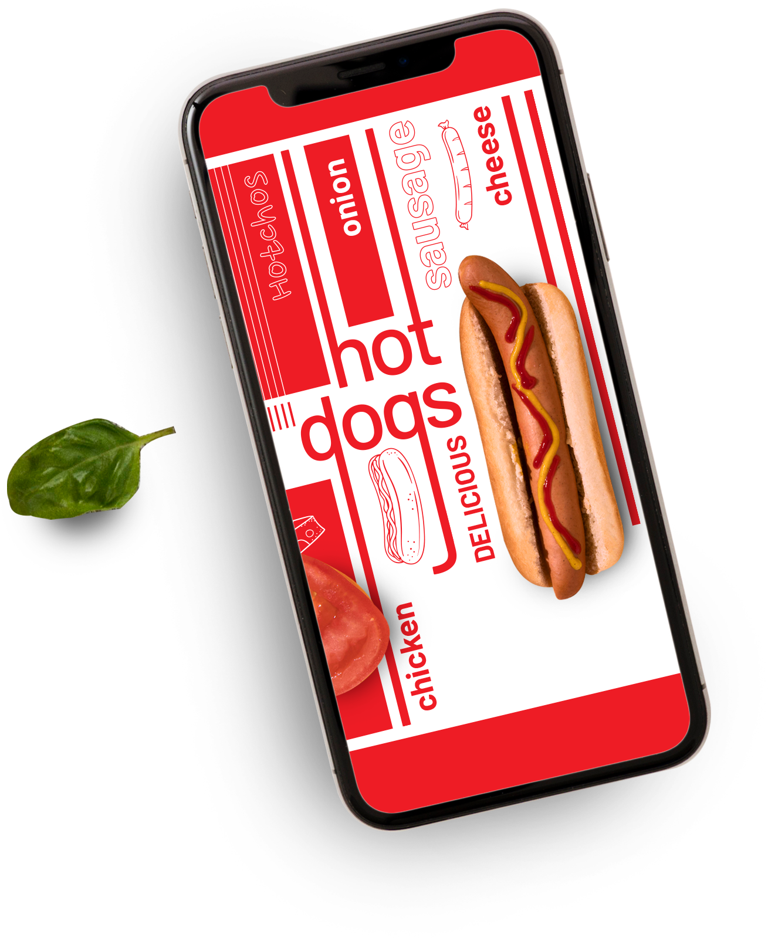



Zomato Case Study
Home Delivery
Prepared by - Kunal Malviya

Slide 2
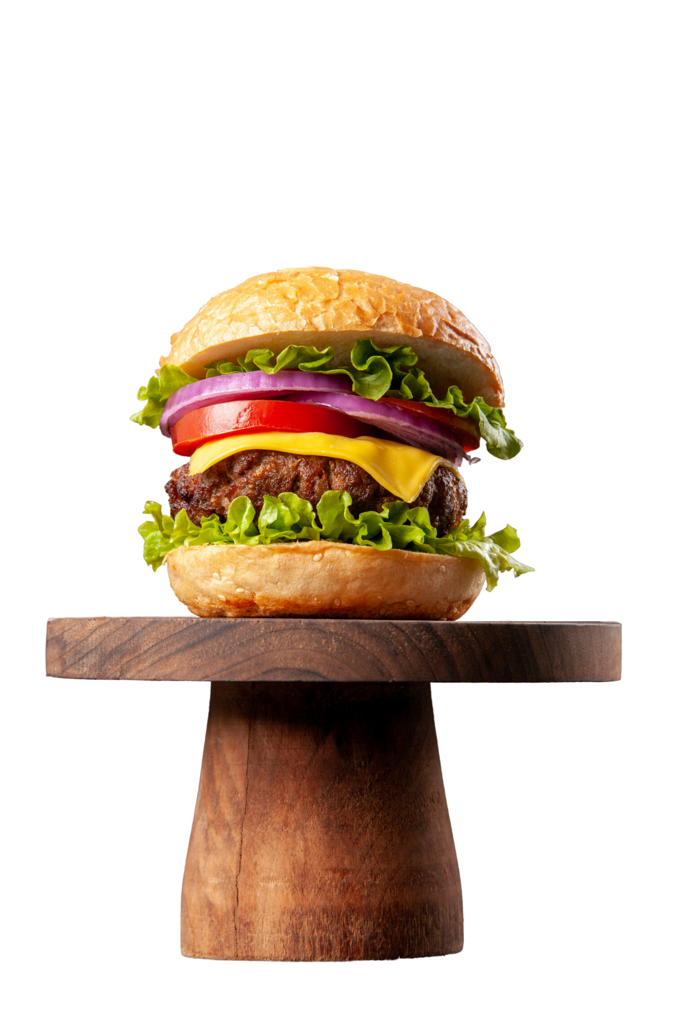


Table Of Contents
01
Problem & Background Statement
02
Stakeholder Involvement
03
Zomato’s Vision & Mission Statement
04
Methodology
05
Recommended Analysis
06
Conclusion

Slide 3
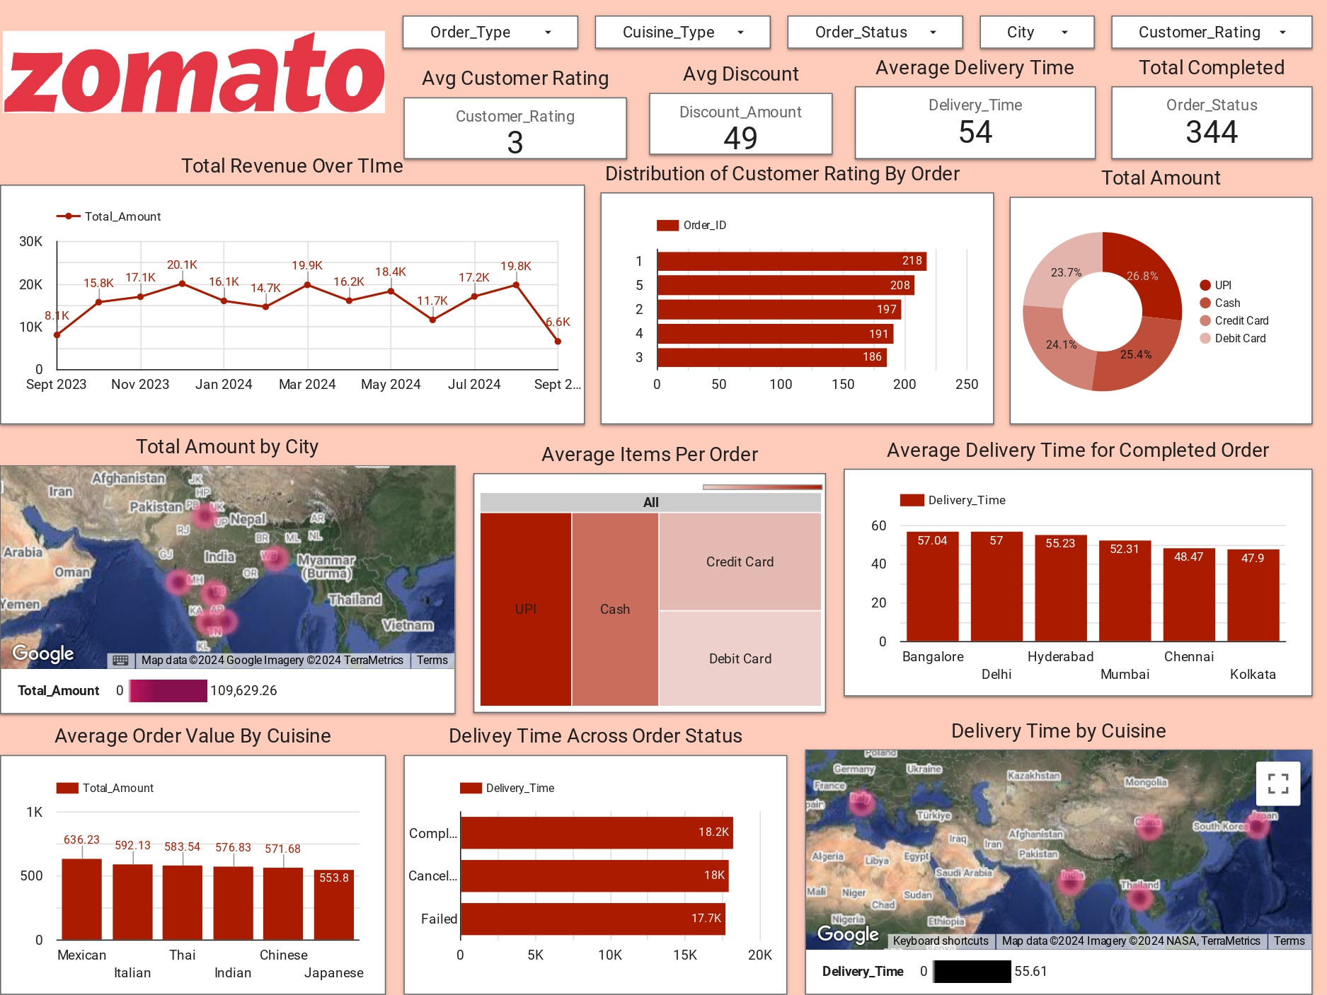
Table Of Contents
01
Problem & Background Statement
02
Stakeholder Involvement
03
Zomato’s Vision & Mission Statement
04
Methodology
05
Recommended Analysis
06
Conclusion

Slide 4



Problem & Background Statement
Zomato is experiencing a decline in customer engagement, marked by increased order cancellations and a reduction in repeat customers. These challenges are impacting the company's customer lifetime value, market share, and reputation. The key issue is identifying the factors contributing to customer dissatisfaction, such as delivery delays and operational inefficiencies. Through a detailed analysis of customer order history, restaurant performance, delivery times, and payment methods, important metrics—such as average delivery time, order cancellation rates, and customer ratings—will be developed to identify pain points and provide actionable insights for improving the customer experience and operational performance.

Slide 5



Stakeholder Involvement
In this case study, various internal and external stakeholders play crucial roles. The Marketing Team focuses on customer retention strategies, while the Operations Team manages the delivery fleet, aiming to reduce delivery times. Customer Support handles customer complaints, including refunds and cancellations, and Executive Leadership requires a summary of findings to guide strategic decisions. Externally, Customers are central to Zomato’s success, as their satisfaction impacts revenue and loyalty. Additionally, Restaurant Partners influence customer satisfaction through their performance and the efficiency of order preparation.

Slide 6

Vision
Mission
To create an exceptional and seamless food delivery experience by addressing customer pain points, enhancing operational efficiency, and ensuring that Zomato becomes the most trusted platform for both customers and restaurant partners, driving long-term engagement and satisfaction.
To identify and resolve factors contributing to customer dissatisfaction by leveraging data-driven insights. This includes improving delivery times, reducing order cancellations, and optimizing restaurant performance to elevate the overall customer experience and reinforce Zomato's commitment to excellence.

Slide 7

Methodology Used
Data sources
SQL
AWS
Data Scraping
Local data sources
Data wrangling
Data understanding
Data cleaning
Data merging and joining
Data manipulation
Data analysis
Finding the trends and patterns

Slide 8

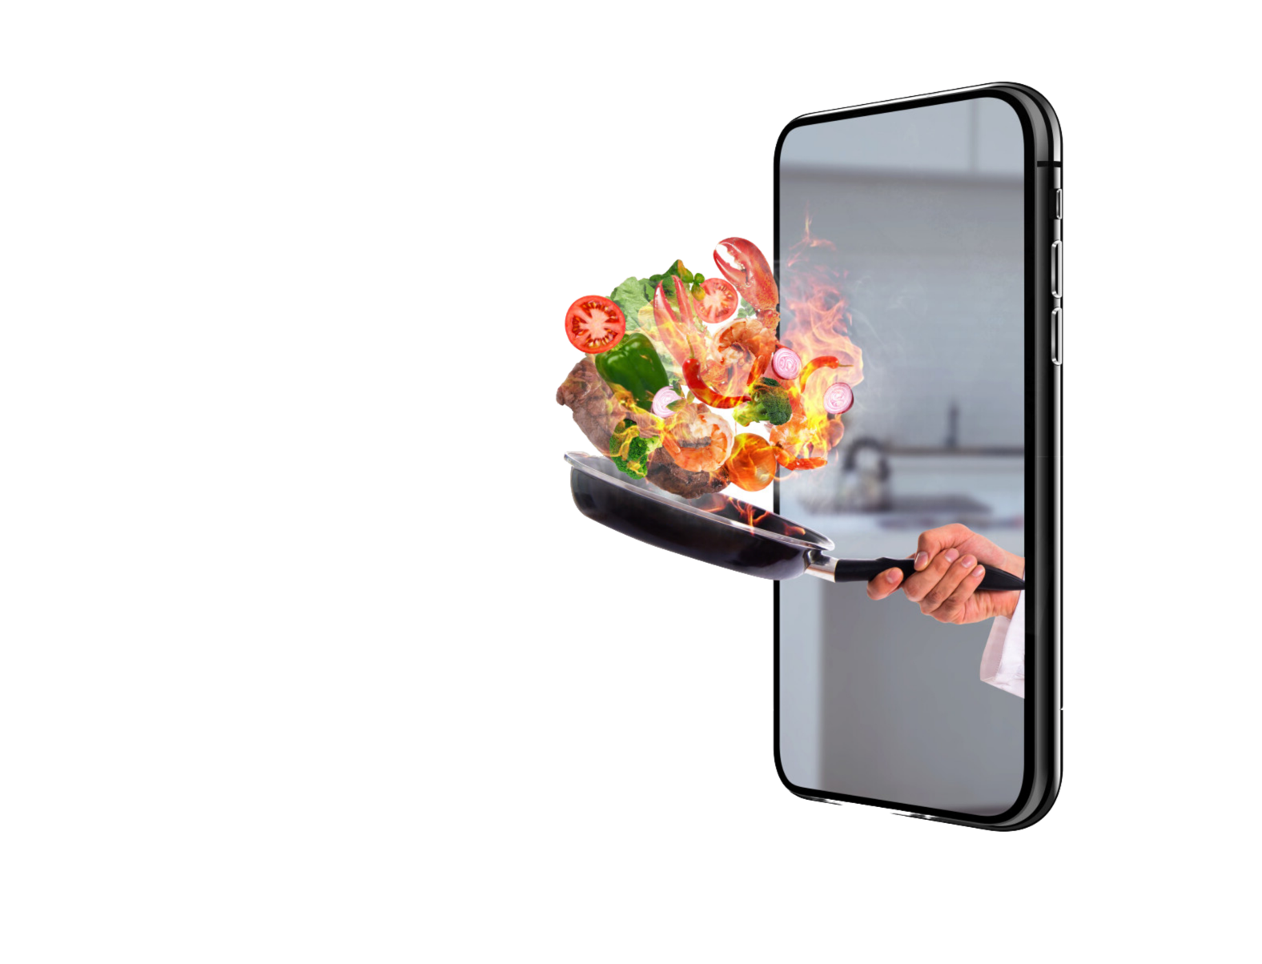

Key Performance Indicator(KPI)
3/5
49
Avg Customer Rating
Avg Discount
344
54 Min
Total Complete Order
Avg Delivery Time

Slide 9
Recommended Analysis
Q1: What is the average delivery time for completed orders across all cities?
Bangalore: 57.04 min
Delhi: 57.00 min
Hyderabad: 55.23 min
Mumbai: 52.31 min
Q2: Which payment method is the most used?
UPI: 27.8%
Cash: 25.4%
Credit Card: 24.1%
Debit Card: 23.7%

Slide 10
Recommended Analysis
Q3: What is the distribution of customer ratings across all orders?
1 star (★): 218 orders
2 stars (★★): 197 orders
3 stars (★★★): 186 orders
4 stars (★★★★): 191 orders
5 stars (★★★★★): 208 orders

Slide 11
Recommended Analysis
Q4: Which cuisine type has the highest average order value?
Mexican: $636.23
Thai: $581.54
Indian: $576.83
Chinese: $571.83
Japanese: $553.80
Italian: $529.13

Slide 12
Conclusion
The analysis of Zomato reveals key factors contributing to customer dissatisfaction, including increased order cancellations and delivery inefficiencies. Mexican cuisine shows the highest average order value, while UPI is the most preferred payment method. The distribution of customer ratings highlights areas needing improvement, particularly in lower star ratings.
By addressing these pain points and enhancing operational processes, Zomato can improve customer satisfaction, retain customers, and drive revenue growth, ultimately strengthening its market position and brand loyalty.

Slide 13

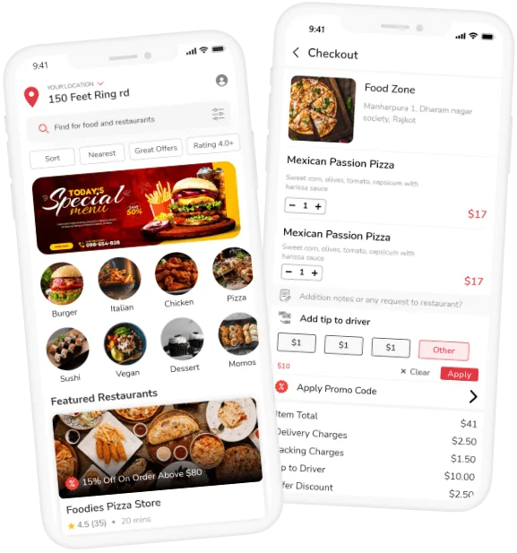
Thank You

